Slide 1
Steering Committee Meeting 8 Cayuga-Oswego CLEAR
Coastal Lakeshore Economy and Resiliency Initiative
November 17, 2021

Slide 2
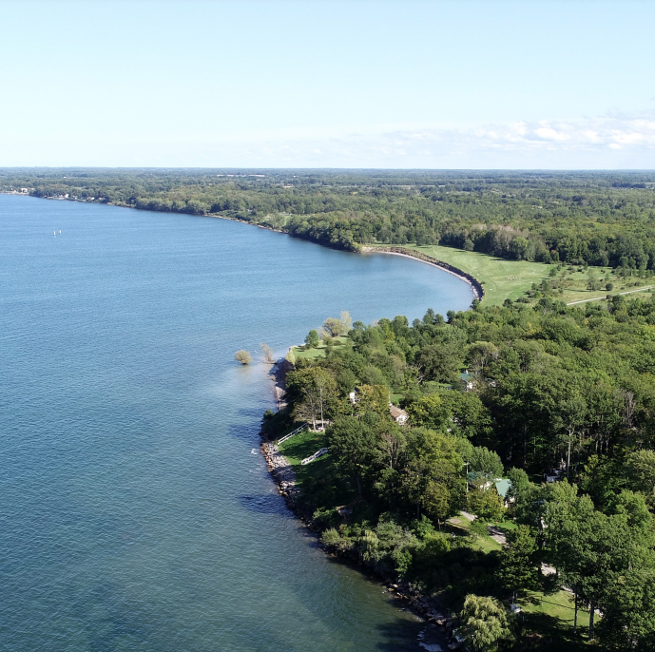
AGENDA
Project Update and Remaining Tasks
Project Profile Discussion
Round Robin Wrap-up
Next Steps and Thank You
Notes:
Photo: NYS Lake Ontario Regional & Economic Development Initiative. 2019. https://www.ny.gov/sites/ny.gov/files/atoms/files/REDI_Project_Profiles_Regional_Projects_20191015.pdf

Slide 3
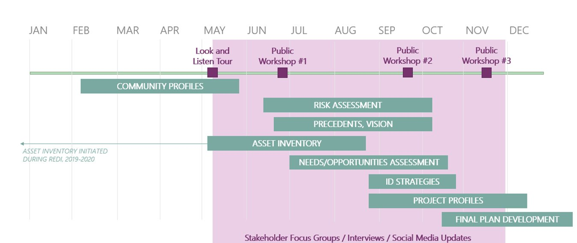
PROJECT TIMELINE

Slide 4
Project Overview Is this strategic? Is it doable?
Project Profile Discussion
Are there any potential project partners you think may be helpful?
Are there names of potential champions that could lead this project?
Are there any challenges that you think may occur?
How can we address/solve these challenges?
How will you stay connected to move this forward?

Slide 5
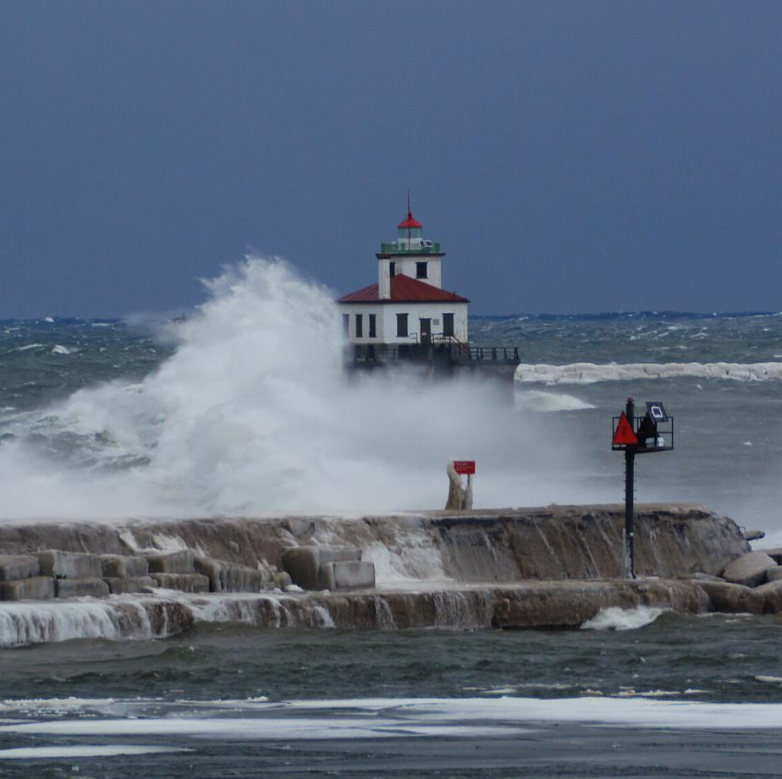
Round Robin Wrap-Up
Your experience with CLEAR
What will you do next?
Notes:
Photo: NYS Lake Ontario Regional & Economic Development Initiative. 2019. https://www.ny.gov/sites/ny.gov/files/atoms/files/REDI_Project_Profiles_Regional_Projects_20191015.pdf

Slide 6
REMAINING STEPS
Draft CLEAR Plan shared the week of November 22
Office hours December 8, 2:00-4:00pm; Zoom link will be sent to you
Final comments on project profiles due December 10
Final Plan ready early 2022 for acceptance by municipalities
Check CLEAR website: www.CNYCLEAR.com for updates

