Slide 1
Steering Committee Meeting 7 Cayuga-Oswego CLEAR
Coastal Lakeshore Economy and Resiliency Initiative
October 27, 2021

Slide 2
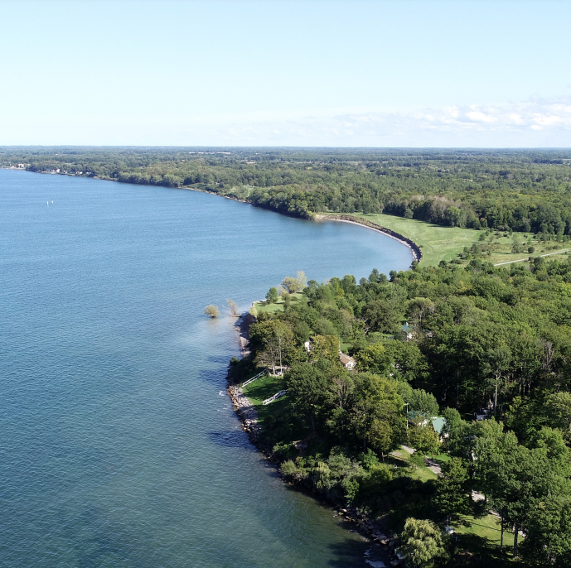
AGENDA
Project Updates
Strategy Matrix
Public Workshop #3
Next Steps & Homework
www.CNYCLEAR.com
Notes:
Photo: NYS Lake Ontario Regional & Economic Development Initiative. 2019. https://www.ny.gov/sites/ny.gov/files/atoms/files/REDI_Project_Profiles_Regional_Projects_20191015.pdf

Slide 3
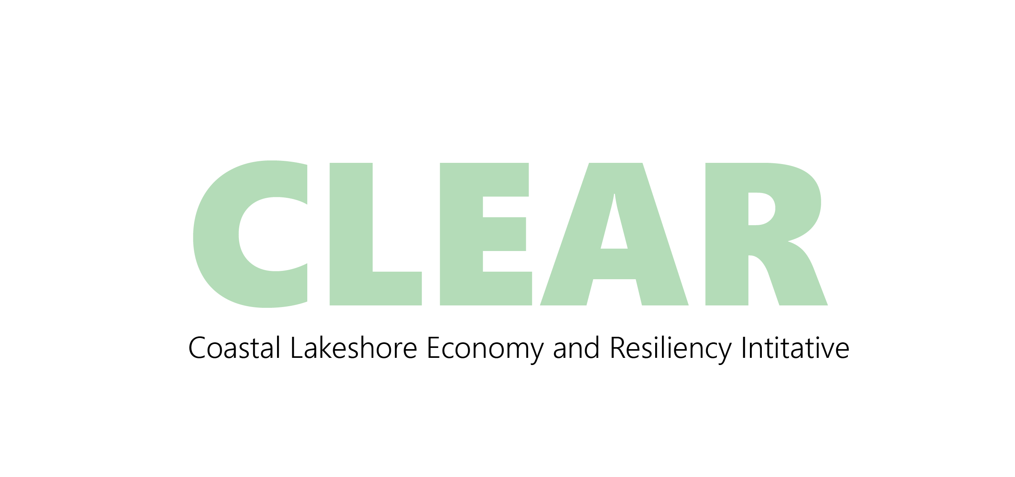
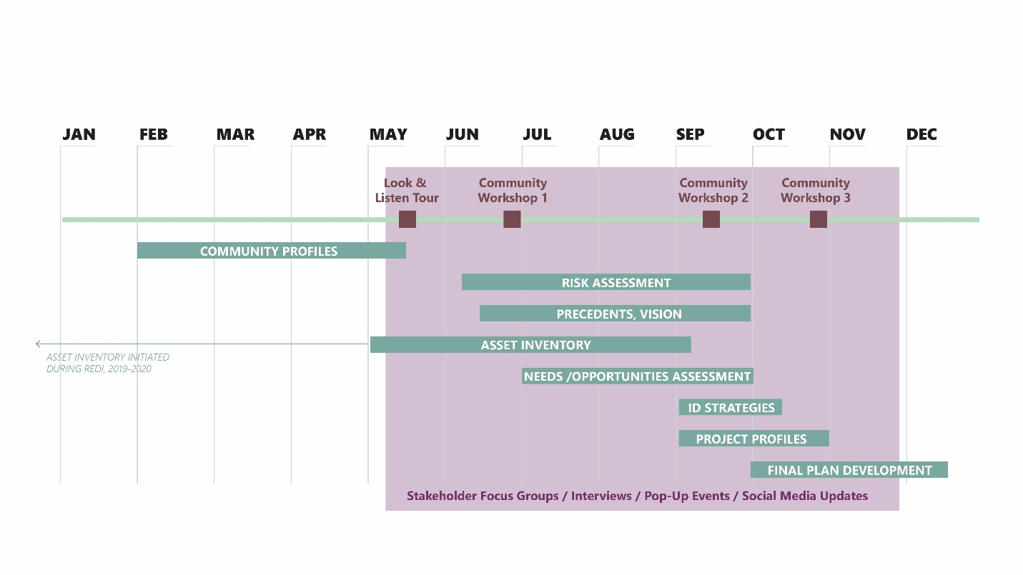
PROJECT TIMELINE
www.CNYCLEAR.com

Slide 4
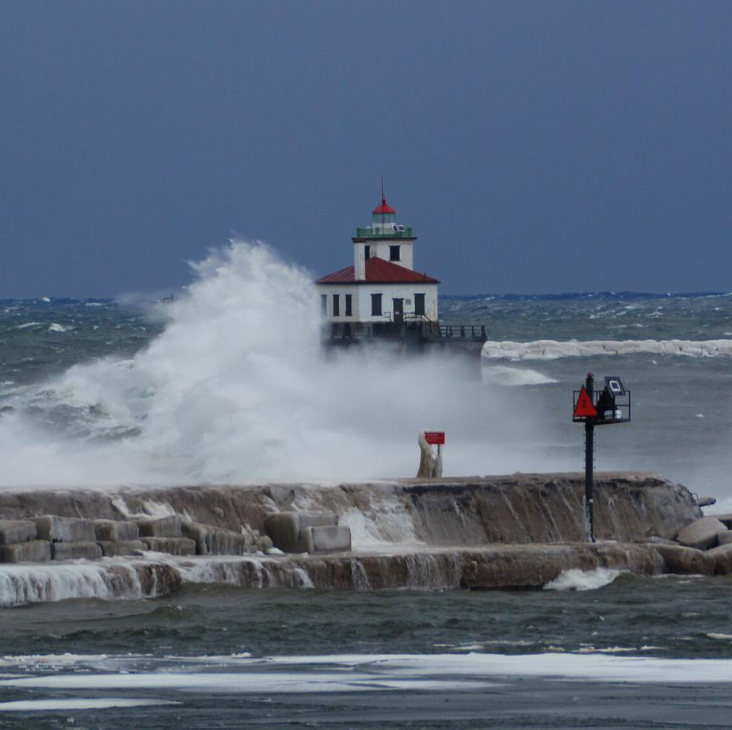
UPDATES
Draft CLEAR Plan: format and timing
Targeted Stakeholder Outreach
www.CNYCLEAR.com
Notes:
Photo: NYS Lake Ontario Regional & Economic Development Initiative. 2019. https://www.ny.gov/sites/ny.gov/files/atoms/files/REDI_Project_Profiles_Regional_Projects_20191015.pdf

Slide 5
Sample Project Profile: Sandy Pond Management Plan
www.CNYCLEAR.com

Slide 6
Strategy Matrix Discussion
www.CNYCLEAR.com

Slide 7
Public Workshop #3
AGENDA
CLEAR Overview
Scenario Planning (Mary Austerman, Sea Grant)
Strategy Matrix Activity
www.CNYCLEAR.com
Notes:
Photo: NYS Lake Ontario Regional & Economic Development Initiative. 2019. https://www.ny.gov/sites/ny.gov/files/atoms/files/REDI_Project_Profiles_Regional_Projects_20191015.pdf

Slide 8
NEXT STEPS
Public Workshop #3 November 10, 6:00-7:30 PM
SC Meeting #8 (final): November 17, 2:00-3:00 PM
Office Hours December 8, 2:00 to 4:00 PM
www.CNYCLEAR.com

Slide 9
HOMEWORK
Promote the Public Workshop
Lay the groundwork for local municipalities to accept the plan
Consider giving a presentation; share the video link
Review draft Strategy Matrix: final comments due October 29
All comments due December 10
www.CNYCLEAR.com

